Slide 1
A Survey on Sensor Networks
Donghyun Kang, Dongkwon Lee
Notes:
Hello everybody,
Prior to the beginning of presentation, My name is Donghyun Kang and his name is Dongkwon Lee.
I’ll present first half and he’ll do second half.
From now on, I’ll begin our presentation.

Slide 2
Contents
Introduction
Sensor Networks Communication Architecture
Protocol Stack
Physical Layer
Data Link Layer
Network Layer
Transport Layer
Application Layer
Conclusion

Slide 3
Introduction
Recent advancement in wireless communications and electronics has enabled…
Sensor Node
Consist of sensing, data processing, and communicating components
Cooperating – The nodes are fitted with an onboard processor
Use processing abilities
Low-cost, Low-power, Multifunctional, Small size
Notes:
Recently, advancement in wireless communications and electronics has enabled a lot of things and one of them is sensor node.
Let’s begin with a sensor node.
It consists of sensing, data processing, and communicating components.
One of big advantages of using sensor node is cooperating.
The nodes are fitted with an onboard processer.
Instead of sending the raw data, it uses its processing abilities to locally carry out simple computations and transmit only the required and partially processed data.
In other word, it is very-very flexible.
Its own features are listed on the slide: low-cost, low-power, multifunctional and quite small size.
It looks quite nice, isn’t it?

Slide 4
Introduction
Sensor Network
Be composed of a large number of sensor nodes that are densely deployed
Position of sensor nodes need not be predetermined
Cooperate effort of sensor nodes
Wide range of applications are ensured
Health
Military
Home
Notes:
Then, I’ll show you about a sensor network and its features.
It is composed of a large number of sensor nodes that are densely deployed either inside the phenomenon or very close to it.
The position of sensor nodes need not be engineered or predetermined, but it also means that sensor network protocols and algorithms must possess self-organizing capabilities.
As I mentioned on the before slide, cooperate effort of sensor nodes make communication more effective.
The above described features ensure a wide range of applications for sensor network, health, military, and home areas are representative applications.

Slide 5
Introduction
Protocols for traditional wireless ad hoc network are not well suited to the sensor networks
Feature | Sensor network | Traditional wireless ad hoc network
# of sensor nodes | Very large | Not that large
Density | Densely deployed | Low density
Failure | Prone to failures | Low failure
Topology | Frequently changed | Rarely changed
Communication | Broadcast communication | Point to point communication
Resource | Limited in power, computation capacities and memory | Not that limited
Global identification | May not have | Yes
Notes:
However, realization mentioned or other sensor network applications require wireless ad hoc networking techniques for communication.
But, exist protocols for traditional wireless ad hoc network are not well suited to the sensor networks because there are so many constraints, features, and requirements for constructing sensor networks.
The number of sensor nodes in a sensor network can be several orders of magnitude higher than the nodes in an ad hoc network.
Sensor nodes are densely deployed
Sensor nodes are prone to failures
The topology of a sensor network changes very frequently
Sensor nodes mainly use a broadcast communication paradigm, whereas most ad hoc networks are base on point to point communications.
Sensor nodes are limited in power, computational capacities and memory
Sensor nodes may not have global identification because of the large amount of overhead and large number of sensors.

Slide 6
Contents
Introduction
Sensor Networks Communication Architecture
Overview
Design Factors
Protocol Stack
Physical Layer
Data Link Layer
Network Layer
Transport Layer
Application Layer
Conclusion

Slide 7
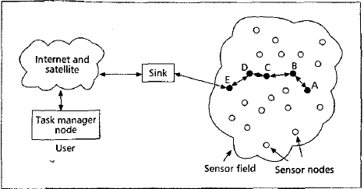
Sensor Networks Communication Architecture
Overview
Sensor nodes
Sensor field
Sink
Notes:
The sensor nodes are usually scatted in a sensor filed. They collect data and route data back to the sink. Data are routed back to the sink by a multi-hop infrastructureless architecture through the sink as shown.
We are going to investigate communication architecture of the sensor networks over there.

Slide 8
Sensor Networks Communication Architecture
Many Design Factors
Fault Tolerance
Scalability
Production Costs
Hardware Constraints
Sensor Network Topology
Environment
Transmission Media
Power Consumption
Notes:
First, the design of the sensor network is influenced by many factors, including fault toleranc ~
These factors are important because they serve as a guideline to design a protocol or an algorithm for sensor networks.

Slide 9
Design Factors
Fault Tolerance
Ability to sustain sensor network functionalities without any interruption due to sensor node failures
Scalability
Hundreds ~ millions of sensor nodes
Production Costs
Notes:
First, The fault tolerance.
Some sensor nodes may fail or be blocked due to lack of power, or have physical damage. The failure of sensor node should not affect the overall task of the sensor network. It should have an ability to sustain sensor network functionalities without any interruption due to sensor node failures.
Second, Scalability.
The number of sensor nodes may be on the order from hundreds to millions, depending on the applications. So new schemes for the sensor networks must be able to work with this number of nodes
Third, Production Cost
Since sensor networks consist of a large number of sensor nodes, the cost of a single node is very important to justify the overall cost of the network.

Slide 10
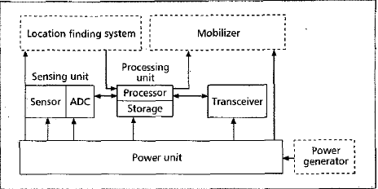
Design Factors
Hardware Constraints
Sensing unit
Sensors
Analog signal
ADC
Analog to Digital Converter
Processing unit
Transceiver unit
Power unit
Application-dependent components
Location finding system, mobilizer, power generator, …
Size (weight) & power constraint
Notes:
Fourth,
A sensor node is made up of four basic components, as shown in the figure, a sensing unit, a processing unit, a transceiver unit, and a power unit.
They may have additional application-dependent components such as a location finding system, power generator, and mobilizer
Sensing units are usually composed of two subunits, sensors and analog to digital converters. The analog signals produced by the sensors converted to digital signals by the ADC, and then fed into the processing unit.
And processing unit manages the procedures that make sensor node collaborate with the other nodes as I mentioned on the introduction slide as cooperate.
Subsequently, a transceiver unit connects the node to the network.
The power unit, one of the most important components, supplies sensor nodes with electric power.
Also there exists application dependent components such as location finding system, mobilizer; which enables moving the sensor node, and power generator.
However, those components should fit into a matchbox size or cubic centimeter and must consume extremely low power

Slide 11
Design Factors
Sensor Network Topology
Pre-deployment & deployment
Post-deployment
Redeployment
Environment
Notes:
Fifth, Sensor network topology. Since a lots of sensor nodes are deployed densely, taking care of topology maintenance is required. It can be specified in three phases, pre-deployment and deployment; in other word, how to locate them, post-deployment phase; topology changes are due to change in sensor nodes’ position, reachability, available energy, and malfunctioning Lastly, redeployment means that additional sensor nodes replace previous node due to malfunctioning or task dynamics.
Sixth, environment, where the sensor nodes work is also one of the constraints.

Slide 12
Design Factors
Transmission Media
Radio
Infrared
Optical media (light)
Power Consumption
Lifetime
Conservation & management
Power-aware protocols & algorithms
Notes:
Seventh, the way to transmission media can be a constraint. Communicating nodes arc linked by a wireless medium and these links can be formed by radio, infrared, radio, or optical media.
Link formed by radio is general solution, but infrared or optical media can be a better solution. But links formed by infrared or optical media require a line of sight between the sender and receiver
In last, limited power source should be considered, it is closely related to the sensor node lifetime. Hence, power conservation and power management take on additional importance in sensor nodes design. And researchers are focusing on the design of power aware protocols and algorithms due to power constraints. Power consumption can be divided into three domains: sensing, communication, and data processing ; as mentioned on hardware constraints part.

Slide 13
Contents
Introduction
Sensor Networks Communication Architecture
Protocol Stack
Physical Layer
Data Link Layer
Network Layer
Transport Layer
Application Layer
Conclusion

Slide 14
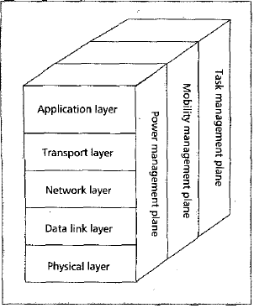
Protocol Stack
Layers
Physical Layer
Transmission & receiving techniques
Data Link Layer
Medium access control protocol w/ considering constraints
Network Layer
Take care of routing the data supplied by the transport layer
Transport Layer
Help to maintain the flow of data
Application Layer
Application software
Notes:
The protocol stack used by the sink and sensor nodes is given in the figure.
This protocol stack also takes care of what we mentioned on previous slides.
The protocol stack consists of the 5 layers and 3 planes.
First, I’ll show you an overview of layers. I’ll explain each layer briefly From below to the top.
Physical layer addresses the transmission and receiving techniques.
Medium access control protocol on data link layer must be power-aware and to minimize collision with neighbor’s broadcasts.
The network layer takes care of routing the data supplied by the transport layer
The transport layer helps to maintain the flow of data if the sensor networks application requires it
Different types of application software can built and used on the application layer

Slide 15
Protocol Stack
Planes
Power management plane
Manage how a sensor node uses its power
Mobility management plane
Detect and register the movement of sensor nodes
Task management plane
Balance and schedule the sensing tasks
Notes:
However, there also exist 3 planes to help the sensor nodes to coordinate the sensing task and lower overall power consumption.
The power management plane manages how a sensor node uses its power for example, when the power level of the sensor node is low, the sensor node broadcasts to its neighbors that it is low in power and cannot participate in routing messages.
The mobility management plane detects and registers the movement of sensor nodes, so a route back to the user is always maintained.
The task management plane balances and schedules the sensing tasks given to a specific region. For example, sensor nodes in specific region perform different sensing task proportional to its power level.
In short, These management planes are needed so that sensor nodes can work together in a power efficient way, route data in a mobile sensor network, and share resources between sensor nodes.

Slide 16
Contents
Introduction
Sensor Networks Communication Architecture
Protocol Stack
Physical Layer
Data Link Layer
Network Layer
Transport Layer
Application Layer
Conclusion
Notes:
Subsequently, we’ll explain each layer in more details.

Slide 17
Physical Layer
Be responsible for
Frequency selection
Carrier frequency generation
Signal detection
Modulation
Data encryption
915 MHz ISM band has been widely suggested for sensor networks
Notes:
The physical layer is responsible for frequency selection, carrier frequency generation, signal detection, modulation and data encryption.
Thus far, the 915 MHz Industrial scientific and medical (ISM) band has bend widely suggested for sensor networks.

Slide 18
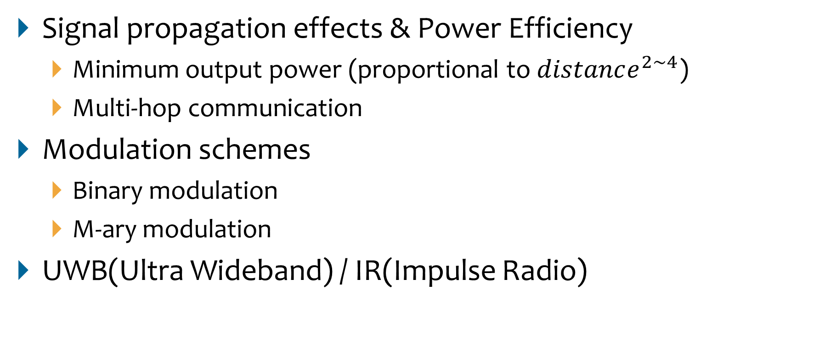
Physical Layer
Signal propagation effects & Power Efficiency
Minimum output power (proportional to $distance^{2\sim 4}$)
Multi-hop communication
Modulation schemes
Binary modulation
M-ary modulation
UWB(Ultra Wideband) / IR(Impulse Radio)
Notes:
However, frequency selection and generation is more related to underlying hardware, it is out of scope and we will discuss about these three small topics.
First, the minimum output power to transmit a signal over a distance d proportional to 2 to 4 magnitude order of distance d.
So, efficient techniques such as multi-hop communication are required.
The choice of a good modulation schemes is critical for reliable communication in a sensor network.
Then binary modulation and M-ary modulation schemes can be compared, M-ary scheme can reduce the transmit on-time by sending multiple bits per symbol but it results in complex circuitry and increased radio power consumption. In short, there exists trade-off between modulation schemes.
This article also suggests ultra wideband and impulse radio as considerable interest for communication applications.

Slide 19
Contents
Introduction
Sensor Networks Communication Architecture
Protocol Stack
Physical Layer
Data Link Layer
Medium Access Control(MAC)
Error Control
Network Layer
Transport Layer
Application Layer
Conclusion

Slide 20
Data Link layer
It ensures reliable point-to-point and point-to-multipoint connections in a communication network
It is responsible for …
Multiplexing of data streams
Data frame detection
Medium access control (MAC)
Two goals in a sensor network
The creation of network infrastructure
Share resources fairly and efficiently
Error control
Notes:
The data link layer ensures reliable point-to-point and point-to multipoint connections in a communication network.
It is responsible for the multiplexing of data streams, data frame detection, medium access and error control. Among these topics, We’ll discuss medium access control and error control strategies for sensor networks.
First, medium access control, maybe you know it as MAC; it is that MAC in MAC address. There are two goals of MAC in a sensor network, one is the creation of network infrastructure; MAC scheme must establish communication links for data transfer among thousands of sensors.
The other is to fairly and efficiently share communication resources between sensor nodes.

Slide 21
MAC (Medium Access Control)
Existing MAC Protocols Cannot Be Used
Existing MAC protocols
Versus Cellular system
Base station – mobile node <-> no central controlling agent
Goal: provision of high quality of service (QoS) & band width efficiency
Power conservation is secondary important (Replenishing battery, unlimited power supplement) <-> it is prime importance in a sensor network
Versus Bluetooth and the mobile ad hoc network (MANET)
Bluetooth
Star network (master node – up to 7 slave nodes)
Transmission power: ~20dBm & transmission range: order of tens of meters
MANET
Goal: the provision of high QoS under mobile conditions
Power is not important (Replaceable battery)
<-> Less mobility rate, frequent topology change
<-> sensor network has more larger number of nodes.
<-> ~ 0dBm transmission power and less radio range
Notes:
However, I said that existing wireless protocol is not able to adjust sensor networks on previous slide. Like as, existing MAC protocols cannot be used for sensor networks. Here are some existing MAC networks for example.
First, Cellular system, which is composed of a base station working as a central controlling agent and mobile nodes. A goal of its MAC protocol is providing a high quality of service and band width efficiency and power conservation assumes only secondary importance since base stations have unlimited power supply and the mobile user can replenish exhausted batteries. Hence, its accessing scheme and its strategy is not suitable for sensor network.
Also, Bluetooth and the mobile ad hoc network, are probably the closest peers to sensor networks
In Bluetooth, its topology is star network and its transmission power is about 20 dBm and order of transmission range is tens of meters.
In MANET, its goal is the provision of high Quality of service under mobile condition and its power is not important due to replaceable battery. Contrarily, in sensor network, it has less mobility rate but more frequent topology change. Also sensor network has more larger number of nodes compared to these two protocols and need quite less transmission power consumption and its radio range is less than them.

Slide 22
MAC (Medium Access Control)
MAC for Sensor Networks
Demand-based schemes may be unsuitable for sensor networks
Large messaging overhead & link setup delay
Fixed allocation and Random access version are suggested
SMACS & EAR
CSMA-based Medium Access
Hybrid TDMA-FDMA based
Power Saving Operation
Notes:
Thus far, both fixed allocation and random access versions of medium access have been proposed;
Demand based MAC schemes may be unsuitable for sensor networks due to their large messaging overhead and link setup delay.
Power conservation is achieved by the use of power saving operation modes and by preferring timeouts to acknowledgments, wherever possible. Some of the proposed MAC protocols are discussed next.

Slide 23
MAC (Medium Access Control)
SMACS and EAR
SMACS: Self-Organizing Medium Access Control for Sensor Networks
Distributed infrastructure-building protocol
Enable nodes to discover their neighbors and establish transmission/reception schedules for global communication without any global or local master nodes
Neighbor discovery and channel assignment phases are combined
Hear all their neighbors -> form a connected network
Communication link – pair of time slots operating at a randomly chosen but fixed frequency <Power conservation>
Available bandwidth >> maximum data rate for sensor nodes
No network wide synchronization
EAR: Eaves-drop-And-Register Algorithm
Offer continuous service to the mobile nodes under both mobile and stationary conditions
Decide when to drop connections while minimizing messaging overhead
Transparent with SMACS; EAR + SMACS available
Network is assumed to be mainly static and mobile node has a number of stationary nodes
Drawback
Possibility that members already belonging to different subnets might never get connected

Slide 24
MAC (Medium Access Control)
CSMA-Based Medium Access
CSMA: A carrier sense multiple access
Traditional CSMA-based schemes
Fundamental assumption of stochastically distributed traffic
Tend to support independent point-to-point flows
<-> Must be able to support variable but highly correlated and dominantly periodic traffic
Listening mechanism & backoff scheme
Constant listen period – energy efficient
Introduction of random delay → Robustness against repeated collisions
Fixed window & backup schemes → maintain proportional fairness
ARC (Adaptive transmission rate control)
Achieve medium access fairness
Control the data origination rate of a node in order to allow the route-through traffic to propagate
Linear increase and multiplicative decrease approach

Slide 25
MAC (Medium Access Control)
Hybrid TDMA/FDMA Based
T(F)DMA: Time/Frequency division multiple access
Assumption
System is made up of energy-constrained sensor nodes that communicate to a single nearby high-powered base station
The machine monitoring application of sensor networks with strict data latency requirements is considered
If the transmitter consumes more power → TDMA
If the receiver consumes more power → FDMA

Slide 26
MAC (Medium Access Control)
Qualitative overview

Slide 27
MAC (Medium Access Control)
Power Saving Modes of Operation
Regardless of medium access scheme
Example: Turn the transceiver off when it is not required
Dependent to its hardware
Characterized by Less power consumption ←→ latency overhead

Slide 28
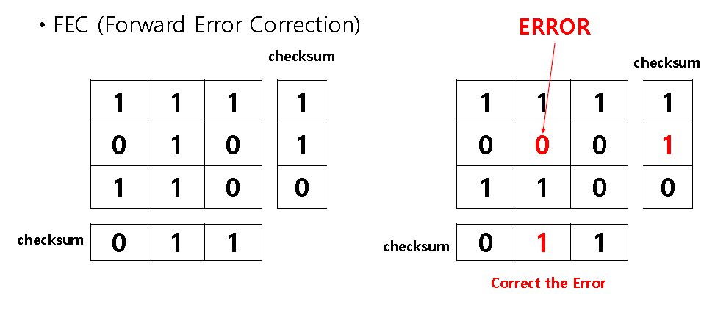
Error Control
Automatic repeat request (ARQ)
Forward Error Correction (FEC)

Slide 29
Contents
Introduction
Sensor Networks Communication Architecture
Protocol Stack
Physical Layer
Data Link Layer
Network Layer
Power efficiency routing(choose path)
Data centric routing(choose source/sink node)
Data aggregation
Sensor network schemes
Transport Layer
Application Layer
Conclusion

Slide 30
Network Layer
Power efficiency routing(choose path)
Data centric routing(choose source/sink node)
Data aggregation
Sensor network schemes

Slide 31
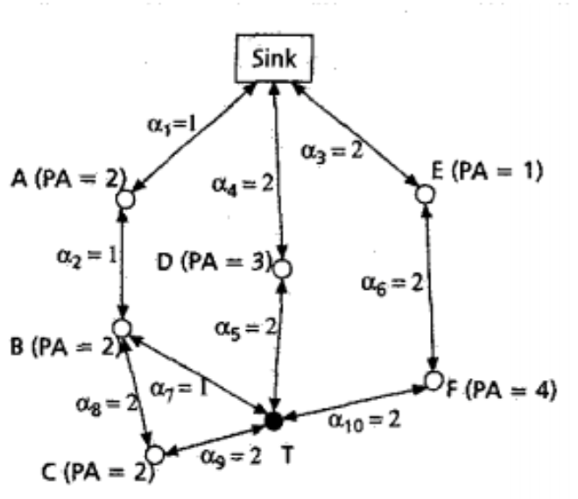
Network Layer
Power efficiency routing
Routing paths(PA : Available power, 𝛼 : required power )
Route 1 : T–B–A–Sink (PA : 4, 𝛼 : 3)
Route 2 : T–C–B–A–Sink (PA : 6, 𝛼 : 6)
Route 3 : T–D–Sink (PA : 3, 𝛼 : 4)
Route 4 : T–F–E– Sink (PA : 5, 𝛼 : 6)

Slide 32
Network Layer
Power efficiency routing
Routing paths(PA : Available power, 𝛼 : required power )
Route 1 : T–B–A–Sink (PA : 4, 𝛼 : 3)
Route 2 : T–C–B–A–Sink (PA : 6, 𝛼 : 6)
Route 3 : T–D–Sink (PA : 3, 𝛼 : 4)
Route 4 : T–F–E– Sink (PA : 5, 𝛼 : 6)
Maximum PA route
Notes:
\

Slide 33
Network Layer
Power efficiency routing
Routing paths(PA : Available power, 𝛼 : required power )
Route 1 : T–B–A–Sink (PA : 4, 𝛼 : 3)
Route 2 : T–C–B–A–Sink (PA : 6, 𝛼 : 6)
Route 3 : T–D–Sink (PA : 3, 𝛼 : 4)
Route 4 : T–F–E– Sink (PA : 5, 𝛼 : 6)
Minimum energy(𝛼) route

Slide 34
Network Layer
Power efficiency routing
Routing paths(PA : Available power, 𝛼 : required power )
Route 1 : T–B–A–Sink (PA : 4, 𝛼 : 3)
Route 2 : T–C–B–A–Sink (PA : 6, 𝛼 : 6)
Route 3 : T–D–Sink (PA : 3, 𝛼 : 4)
Route 4 : T–F–E– Sink (PA : 5, 𝛼 : 6)
Minimum hop(node) route

Slide 35
Network Layer
Power efficiency routing
Routing paths(PA : Available power, 𝛼 : required power )
Route 1 : T–B–A–Sink (PA : 4, 𝛼 : 3)
Route 2 : T–C–B–A–Sink (PA : 6, 𝛼 : 6)
Route 3 : T–D–Sink (PA : 3, 𝛼 : 4)
Route 4 : T–F–E– Sink (PA : 5, 𝛼 : 6)
Maximum ‘minimum PA’ route
Notes:
여기까지는 주어진 패스들에 대해서 어떤 패스가 가장 좋을지를 판단하는 과정이라고 생각해보자.
이제는 데이터센트릭한 라우팅에 대해 말할것이다.

Slide 36
Network Layer
Data Centric Routing
Interest dissemination from sink nodes
Advertise available data from sensor nodes

Slide 37
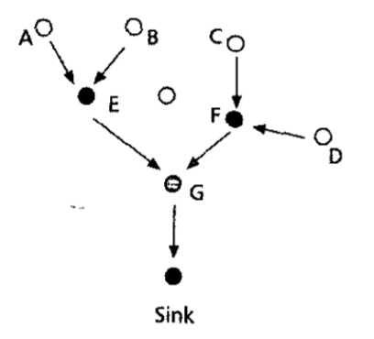
Network Layer
Data aggregation
To avoid implosion and overlap
Notes:
데이터퓨전이라고도 불림. 정보의 출처 등 데이터 합치는 과정에서 손실되면 안되는 것들이 있으므로 특정한 방법을 잘 써줘야한다.

Slide 38
Network Layer
Sensor network schemes
SMECN
FLOODING
GOSSIPING
SPIN
SAR
LEACH
Directed Diffusion
Notes:
데이터퓨전이라고도 불림. 정보의 출처 등 데이터 합치는 과정에서 손실되면 안되는 것들이 있으므로 특정한 방법을 잘 써줘야한다.

Slide 39
Network Layer
SMECN(Small Minimum Energy Communication Network)
Creates a subgraph of the sensor network that contains the minimum energy path
Notes:
데이터퓨전이라고도 불림. 정보의 출처 등 데이터 합치는 과정에서 손실되면 안되는 것들이 있으므로 특정한 방법을 잘 써줘야한다.

Slide 40
Network Layer
FLOODING
Old technique, broadcast data to all neighbor nodes regardless if they receive before or not
Implosion, Overlap, Resource blindness problem
GOSSIPING
Sends data to one random neighbor node
Avoid implosion problem, low performance
Notes:
임플로젼 : 한 노드에 중복된 데이터가 전송되는
오버랩 : 두 노드가 같은 센싱범위를 가지고있어서 인접노드가 중복된 메시지 받음
블라인드니스 : 에너지가 얼마나 허용되는지에 대한 고려를 안함

Slide 41
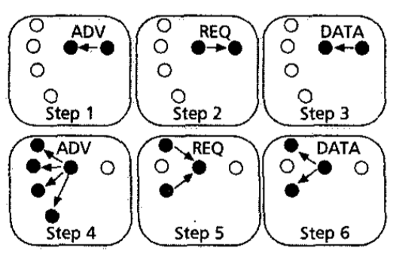
Network Layer
SPIN(Sensor Protocols for Information via Negotiation)
Sends data to sensor nodes only if they are interested
3 types of message; ADV, REQ, DATA
Notes:
데이터퓨전이라고도 불림. 정보의 출처 등 데이터 합치는 과정에서 손실되면 안되는 것들이 있으므로 특정한 방법을 잘 써줘야한다.

Slide 42
Network Layer
SAR(Sequential Assignment Routing)
Creates multiple trees where the root of each tree is a one hop neighbor from the sink
Trees grow outward from the sink
Choose path based on energy resources, additive QoS metric, packet’s priority level.

Slide 43
Network Layer
LEACH(Low-Energy Adaptive Clustering Hierarchy)
Forms clusters to minimize energy dissipation
Randomly select sensor nodes as cluster heads
High energy dissipation in communicating with the base station is spread to all sensor nodes
Two phases

Slide 44
Network Layer
LEACH(Low-Energy Adaptive Clustering Hierarchy)
Setup Phase
Cluster heads are selected randomly
Each sensor node is associated with its cluster head
Steady Phase
Sensor nodes begin sensing and sending data to head
Cluster heads aggregate data and send it to the base station
Notes:
• Communication between sensor nodes and clusterheads is TDMA approach

Slide 45
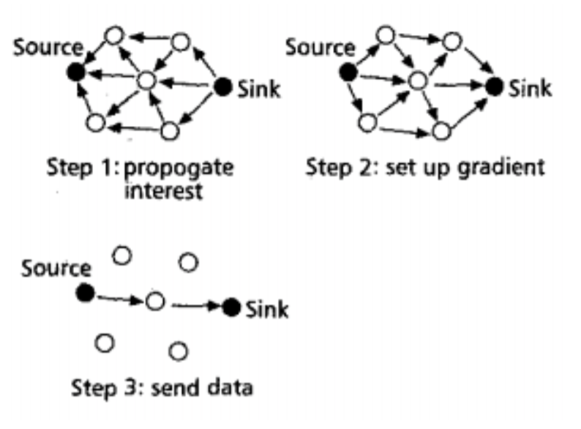
Network Layer
Directed Diffusion
Sink sends interest
Gradients are set up
Source sends the data
Sink refreshes and
reinforces the interest
Based on data
centric routing
Notes:
데이터퓨전이라고도 불림. 정보의 출처 등 데이터 합치는 과정에서 손실되면 안되는 것들이 있으므로 특정한 방법을 잘 써줘야한다.

Slide 46
Contents
Introduction
Sensor Networks Communication Architecture
Protocol Stack
Physical Layer
Data Link Layer
Network Layer
Transport Layer
Application Layer
Conclusion

Slide 47
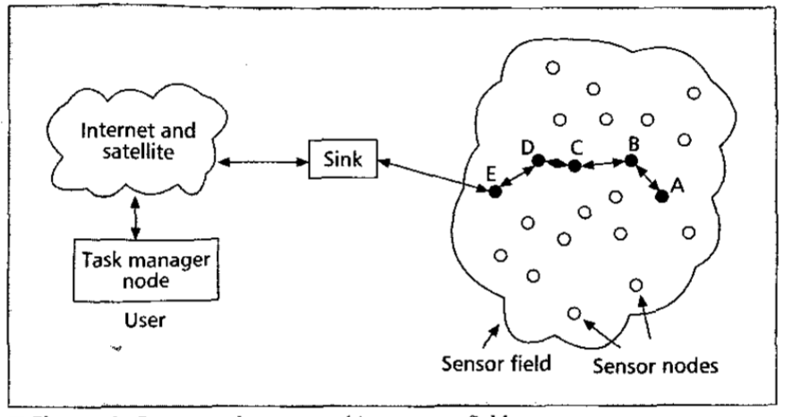
Transport Layer
Access to Internet or other external network
Hybrid approach
TCP(sink – internet) + UDP(sink – sensor nodes)
Notes:
아직까지 좋은 방법이 제시되진 않음. (TCP가 센서네트워크 환경에 잘 안맞음.)
각 노드가 제한된 리소스를 갖고있어서.
Attribute based : 전력소비나 스캐일러빌리티 통해서 주소를 결정하는

Slide 48
Contents
Introduction
Sensor Networks Communication Architecture
Protocol Stack
Physical Layer
Data Link Layer
Network Layer
Transport Layer
Application Layer
Largely unexplored region
Application layer protocols
Conclusion

Slide 49
Application Layer
Largely unexplored region
Application layer protocols
SMP
TADAP
SQDDP

Slide 50
Application Layer
SMP(Sensor Management Protocol)
System admin interacts with sensor networks
Administrative tasks
Introducing rules about data aggregation, attribute based naming and clustering to sensor nodes
Exchanging data related to the location finding algorithms
Time synchronization
Moving sensor nodes
Turning sensor nodes on/off
Querying network configuration, nodes` status
Reconfiguring sensor networks
Authentication, security

Slide 51
Application Layer
TADAP(Task Assignment and Data Advertisement Protocol)
Efficient interest dissemination interface
Interest dissemination by users
Data advertisement by sensor nodes
Helps data-centric routings in lower layers

Slide 52
Application Layer
SQDDP(Sensor Query and Data Dissemination Protocol)
Provides user applications with interfaces to issue query, respond to queries and collecting incoming replies
Attribute, location based querying

Slide 53
Contents
Introduction
Sensor Networks Communication Architecture
Protocol Stack
Physical Layer
Data Link Layer
Network Layer
Transport Layer
Application Layer
Conclusion

Slide 54
Conclusion
Realization of sensor networks needs to satisfy constraints
Since the constraints are specific for sensor networks, new wireless ad hoc networking techniques are required
Notes:
ealization of sensor networks needs to satisfy constraints
• Since the constraints are specific for sensor networks, new wireless ad hoc networking techniques are required

